Slide 1
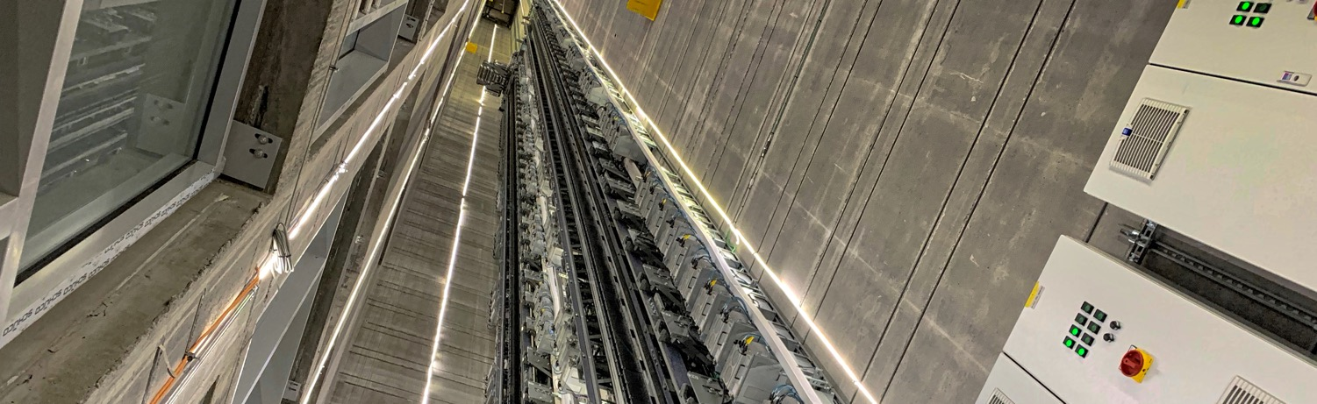


Shadow Models
Incremental Model Transformations as an Enabler for Language Implementations
voelter@acm.org
www.voelter.de
@markusvoelter
Markus Völter

Slide 2
What is Shadow Models?
Functional transformation language with support for fixpoints
Incremental execution upon change of input model
Unidirectional, but with first-class support for lifting results
Fully integrated into MPS IDE
Code: https://github.com/JetBrains/MPS-extensions/tree/master/code/shadowmodels
Docs: https://jetbrains.github.io/MPS-extensions/extensions/shadowmodels/

Slide 3
Mechanics
User edits the input model
A delta is propagated into the transformation engine
A change on the shadow model is produced
This triggers analysis or update of results in Shadow Model
Results/messages are lifted back to input level
Results are annotated to the input model
Input Model
‚
Might be stacked
Shadow Model
...

Slide 4
Example Use Cases
Mapping of system models to model checkers for interactive verification of temporal properties
Flattening of component hierarchies for type checking
Flattening of hierarchical feature models for path expression evaluation
Weaving in of safety concerns into C code.
Desugaring of business DSLs to a core functional language; that core language would then feature an interpreter, a compiler and an integration with an SMT solver

Slide 6
Use Case: Safety Patterns

Slide 7
Use Case: Safety Patterns

Slide 8
Use Case: Safety Patterns
+

Slide 9
Use Case: Safety Patterns
=
+

Slide 11
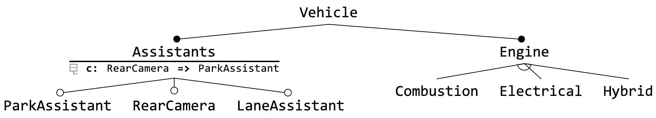
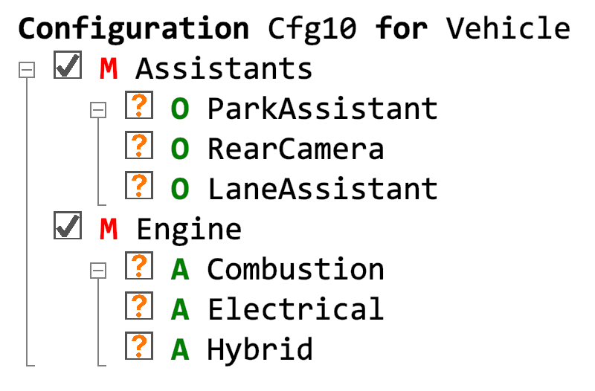
Use Case: Interactive FM Specialization
Klaus Birken

Slide 12
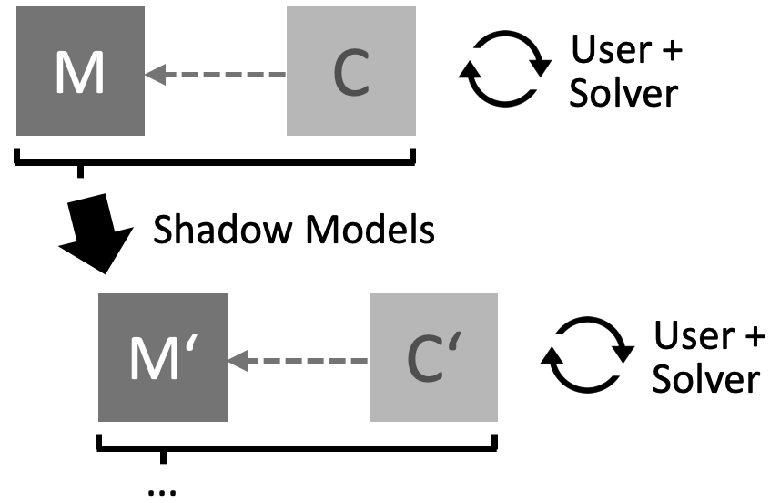
Use Case: Interactive FM Specialization
Klaus Birken

Slide 13
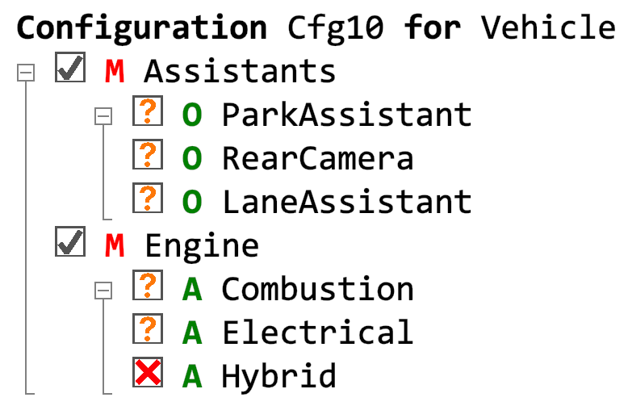
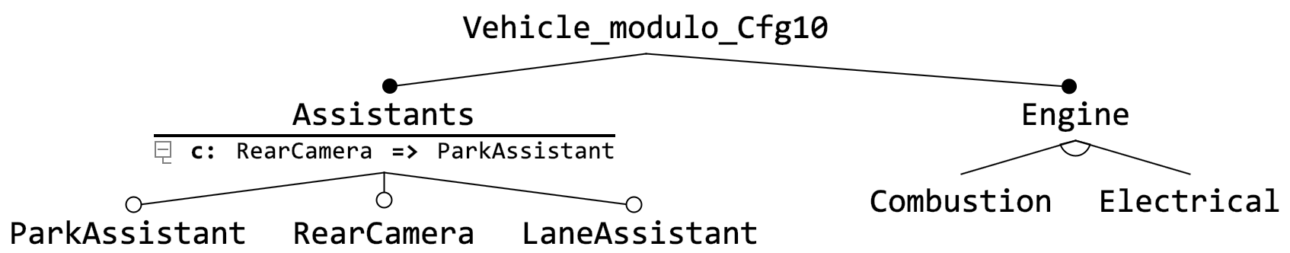
Use Case: Interactive FM Specialization
Klaus Birken
Uncheck
Hybrid

Slide 14
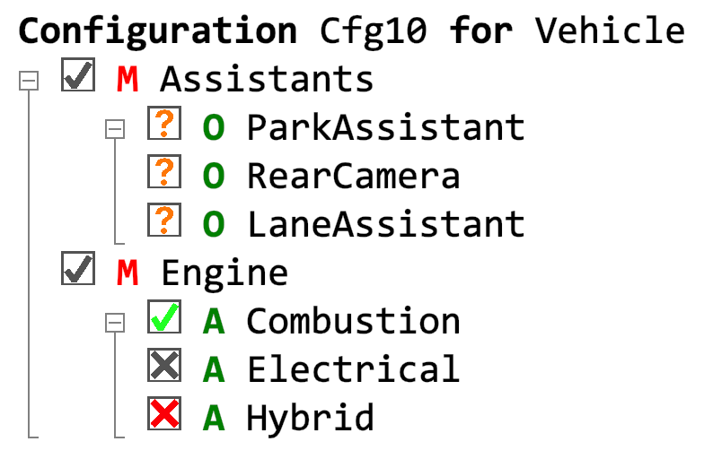
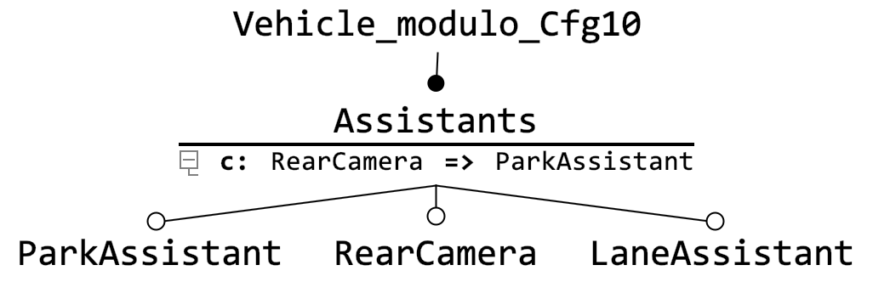
Use Case: Interactive FM Specialization
Klaus Birken
Check
Combustion

Slide 15
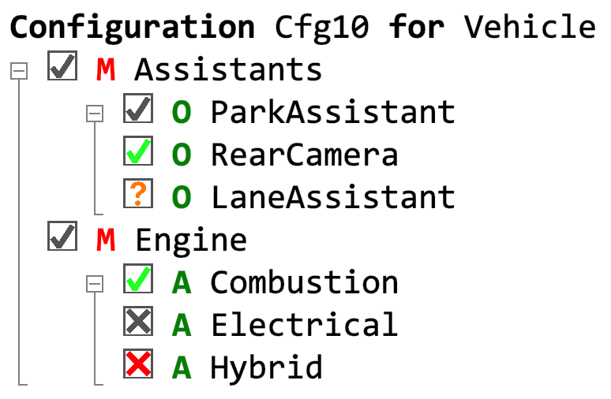
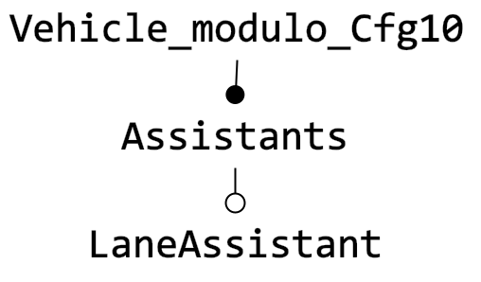
Use Case: Interactive FM Specialization
Klaus Birken
Check
RearCamera

Slide 17
Example Input

Slide 18
Example Shadow

Slide 19
Use Case: Kf2
Minimal, Expressive Core
Functional
Reactive
Sugar on top
Interpter, Generator and Verifier below
Realtime-Trafo with Shadow Models
DSL₁
DSL₂
DSL₃
Sugar
Shadow Models
Core
Interpreter
Generator
Verifier

Slide 21
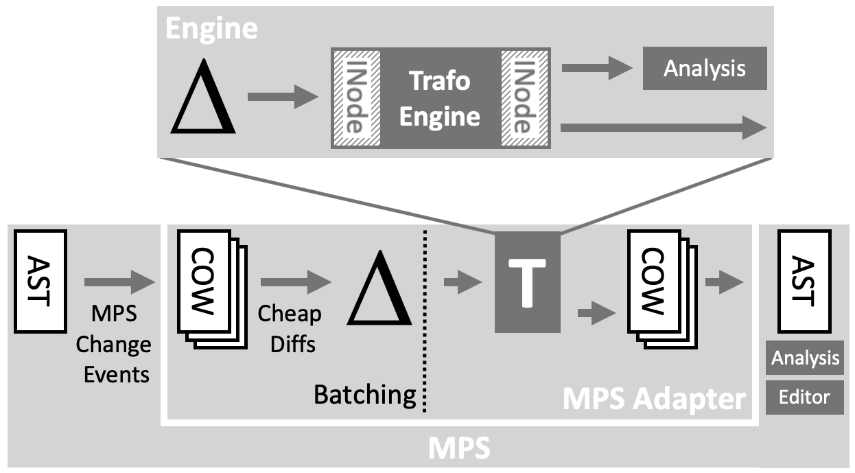
Engine

Slide 23
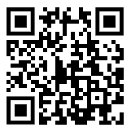
Current State (August 2019)
Still under active development.
Primarily by Sascha Lisson.
Used for initial use cases at itemis Stuttgart.
A paper (SLE 2019 Tool Demo Track) is here:
http://voelter.de/data/pub/shadowmodels-tr.pdf

Slide 24
?
voelter@acm.org
www.voelter.de
@markusvoelter
Markus Völter

